Slide 1
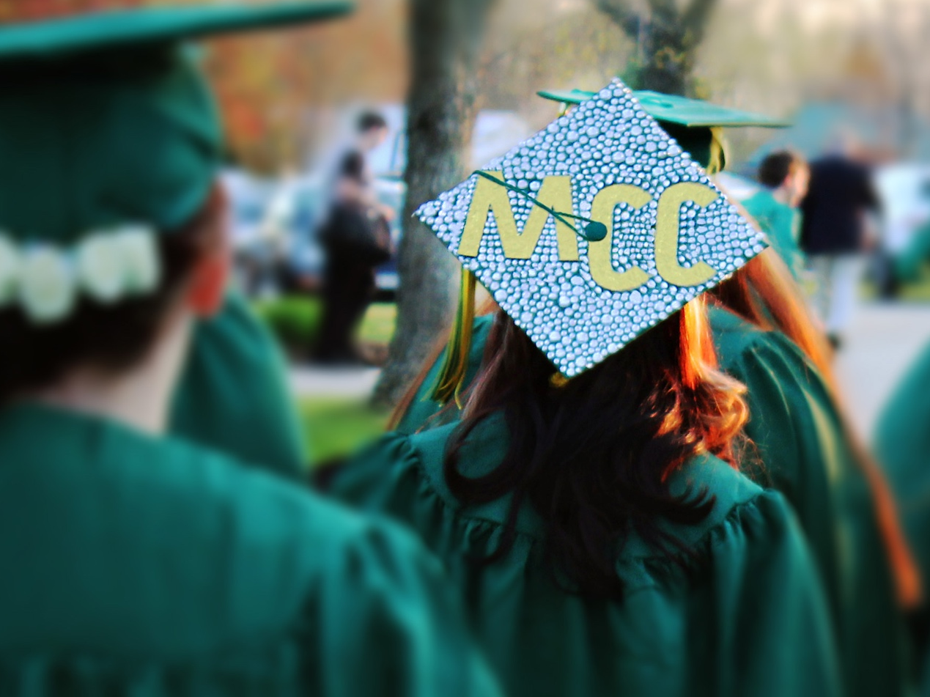

Slide 2
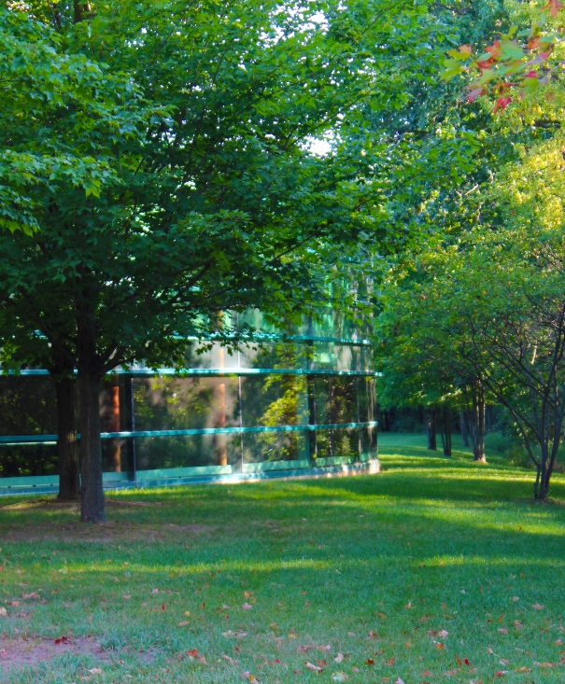
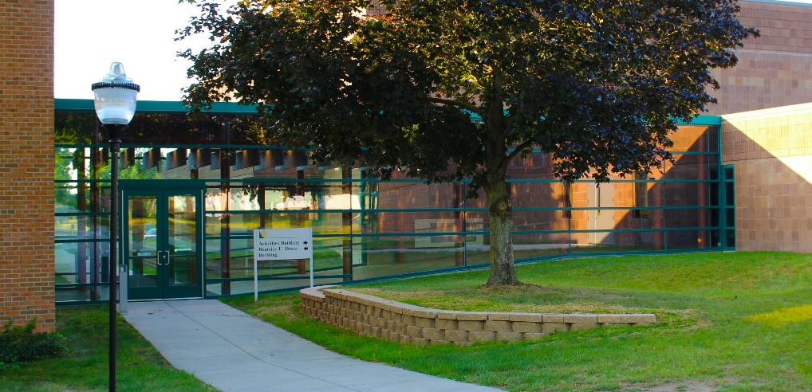
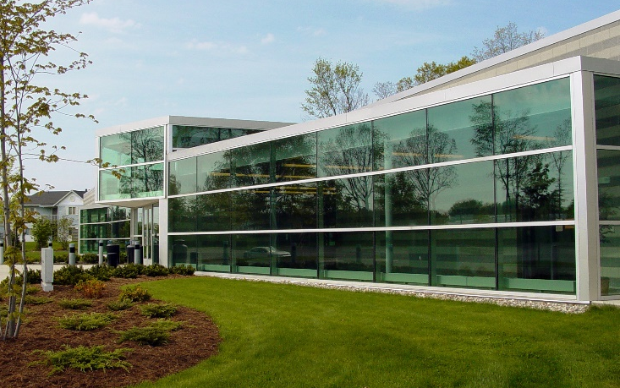

Our name says it all
Montcalm Community College
is YOUR community college.
Notes:
Montcalm Community College was established 45 years ago on the former Anderson Farm in Sidney.
The main campus is situated on 220 acres.
Fall enrollment of 2,113 students.
In the upper right is MCC’s newest building. The Stanley P. Ash Building opened in October 2007 and feature’s state-of-the-art technology for biology, chemistry and nursing instruction. It was named posthumously for longtime Greenville businessman Stanley P. Ash.
The center photo is the Beatrice E. Doser Building in Sidney, named for longtime MCC Board of Trustees Chairperson Beatrice E. Doser. It houses a variety of classrooms, computer labs, the college’s testing center and public conference rooms.
At left is MCC’s M-TEC in Greenville.
Additional sites include the M-TEC in Greenville, the Panhandle Area Center in Howard City and the Ionia Center in Ionia.

Slide 3

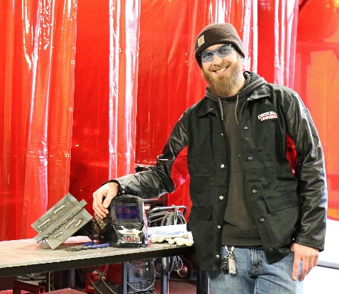
MCC grows leaders
Skilled trades and
advanced manufacturing, agriculture, business,
health careers, computer information systems,
welding – we offer 52
associate degree,
certificate and job-training
programs.
Notes:
Nationally, 43 percent of college students begin their education at a community college.
MCC offers 65 associate degree, certificate and job-training programs; courses that will transfer to bachelor’s programs; and articulations with other colleges that offer students a seamless transfer.
MCC combines state-of-the-art facilities and technology with its highly qualified instructors, small class sizes and affordable tuition to meet the educational needs of its community.
At MCC, we offer both credit and noncredit classes covering a variety of topics, from arts and humanities, sciences, computer technology and physical fitness.

Slide 4
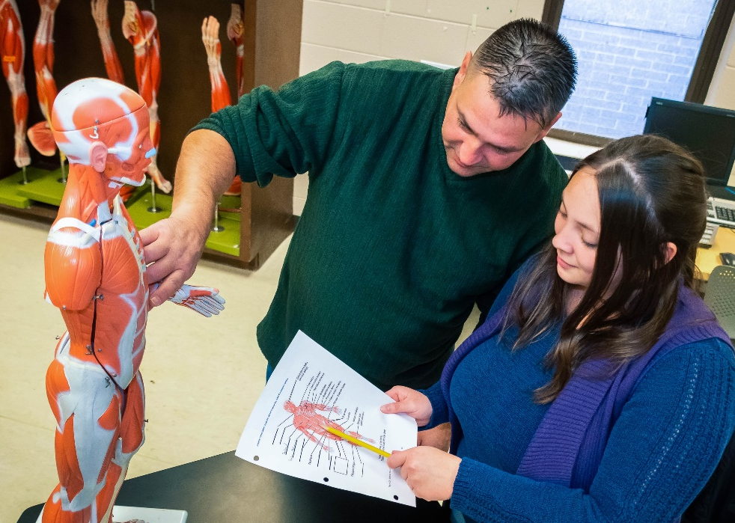
We’re here for you
MCC is an “open door”
institution, providing
educational opportunities
for all who seek them.
Anyone who is 18 years
of age or older or whose
high school class has
graduated, is eligible to
attend MCC as a degree-seeking student. Anyone younger than age 18 may attend as a non-degree seeking student.
Notes:
Nationally, 43 percent of college students begin their education at a community college.
MCC offers 65 associate degree, certificate and job-training programs; courses that will transfer to bachelor’s programs; and articulations with other colleges that offer students a seamless transfer.
MCC combines state-of-the-art facilities and technology with its highly qualified instructors, small class sizes and affordable tuition to meet the educational needs of its community.
At MCC, we offer both credit and noncredit classes covering a variety of topics, from arts and humanities, sciences, computer technology and physical fitness.

Slide 5
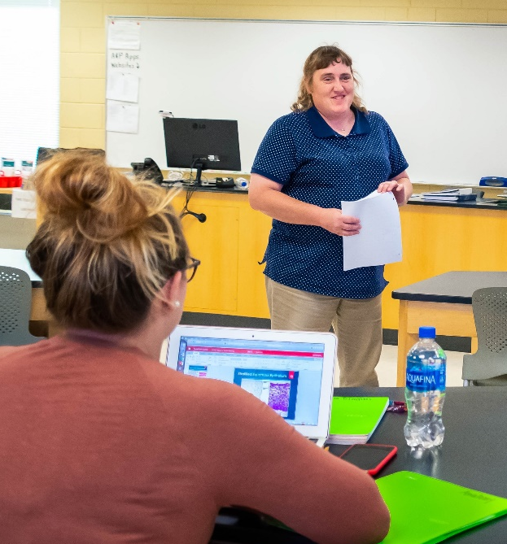
Flexible learning opportunities
MCC offers in-person,
online and hybrid
classes.
Notes:
Online courses allow students to complete their coursework anywhere, at any time.

Slide 6
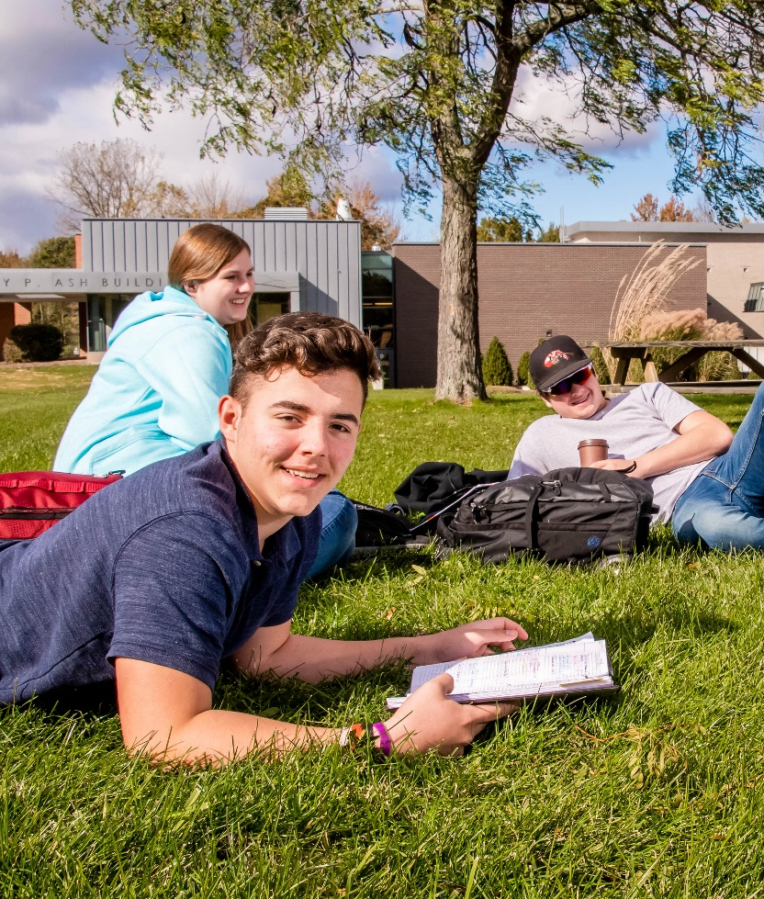
Focus on Student Success
MCC’s Student Success Center is a full-service center geared toward curriculum support for students. Services include:
Academic counseling and advising
Free tutoring
Accessibility services
Testing center, proctored testing and assessment testing
Notes:
Online courses allow students to complete their coursework anywhere, at any time.

Slide 7

College completion
MCC awarded 310 degrees
and certificates May 3
during its 52nd annual
commencement ceremony
Notes:
Online courses allow students to complete their coursework anywhere, at any time.

Slide 8
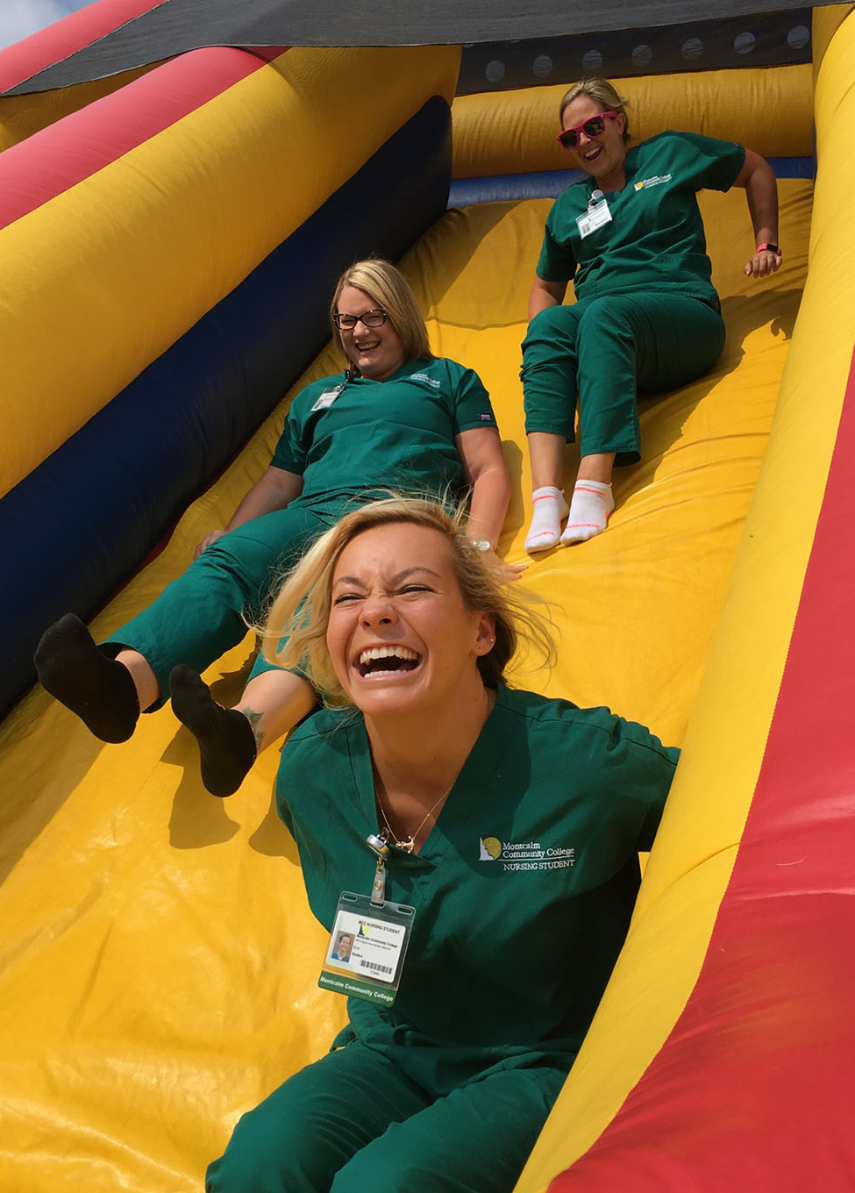
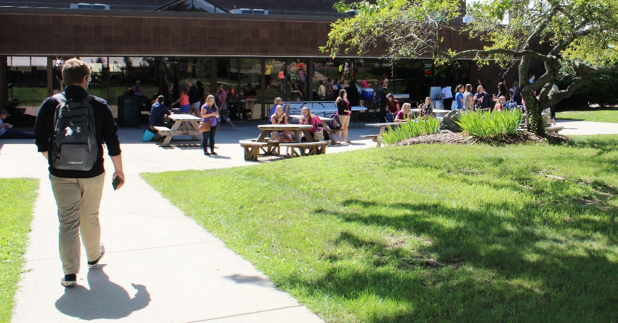
Student satisfaction
According to our latest student satisfaction survey, 99 percent of our graduates said they would recommend MCC to family and friends.
Notes:
Online courses allow students to complete their coursework anywhere, at any time.

Slide 9
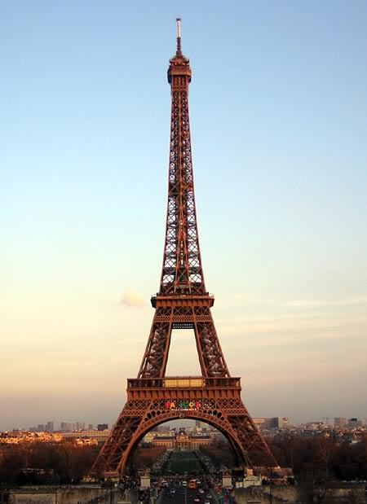
Small college, big reach
Study Abroad with MCC
in London and Paris
in June 2020.
Previous Study Abroad trips
include: India, 2018;
China, 2015; Rome,
Florence and Pompeii, 2011;
London, 2010; and Mexico, 2009.
Notes:
This eight-day trip will be led by Visual Arts Coordinator Carolyn Johnson.
The cost is $2,962, which includes airfare, hotel accommodations and some meals.

Slide 10
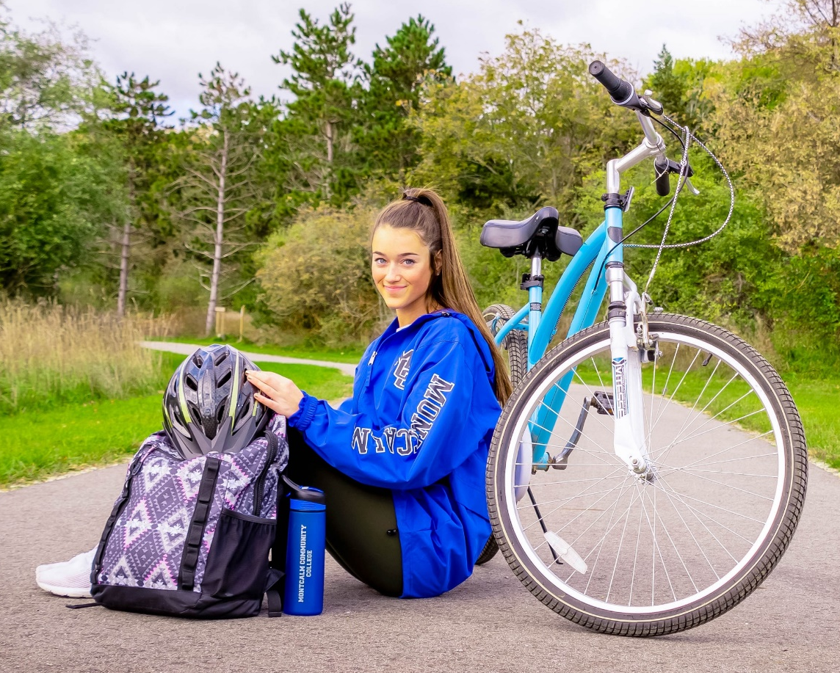
Student life
MCC has 16 active
student clubs,
an award-winning
Phi Theta Kappa
honor society, and
special events and
celebrations
throughout the year.

Slide 11
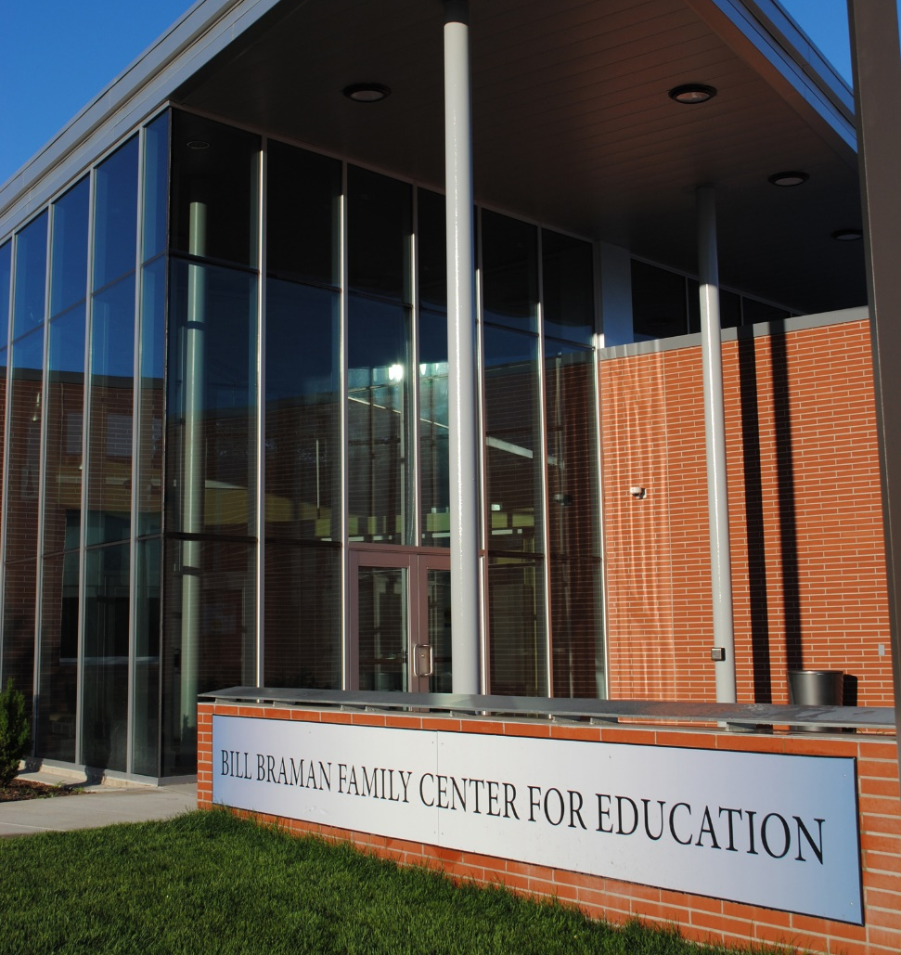
Excellent facilities
MCC’s main campus
is located on 220
beautiful acres in
Sidney. The college’s
Greenville campus is
next to Greenville
High School and serves as
the college’s center
for skilled trades and
advanced manufacturing.

Slide 12
MCC Foundation supports students
MCC and the MCC Foundation work together to support student success. Together, they are offering more than $300,000 in scholarships to students for the 2019-2020 academic year.

Slide 13
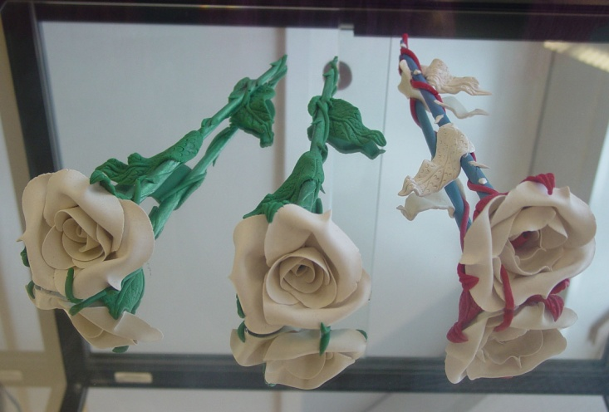
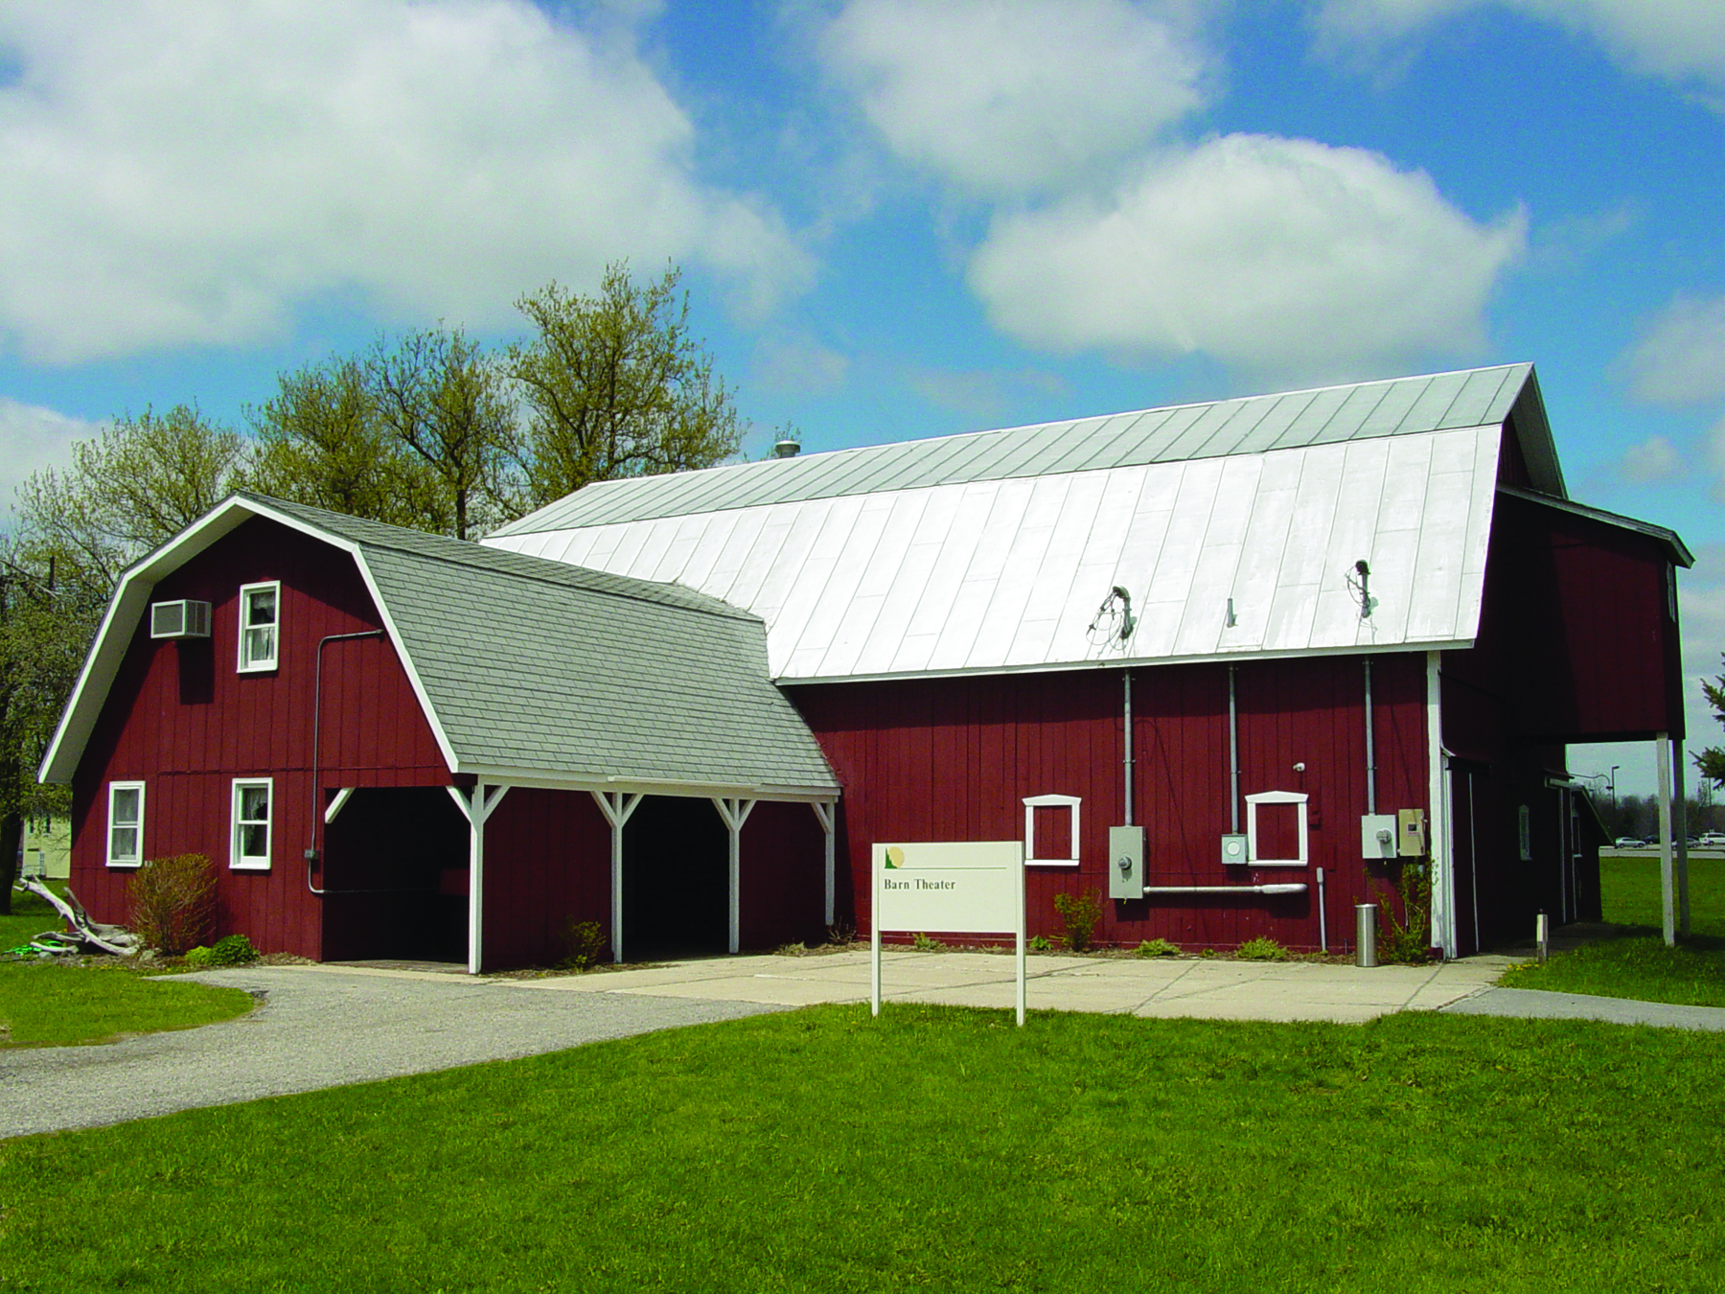
Arts and culture
MCC offers a variety of
cultural events including
art, music and nationally-
and internationally-known
speakers.
Notes:
Our cultural events calendar is second to none.
Until Nov. 20, view a 3-D art show featuring pieces from this year’s ArtPrize, plus many more.
This weekend, MCC’s drama class presents “Meeting Sam,” in the Barn Theater.
Nov. 18 features “The History of Montcalm County” by Linda Collins, director of the Flat River Historical Museum.
Beginning Dec. 1 a religious artifacts exhibit will be on display in MCC’s Art Gallery in the Instruction North Building.
Visit our Web site for more details www.montcalm.edu

Slide 14










Start here, go anywhere
MCC has
partnerships
with many
four-year
institutions,
which offer
seamless
transfer
options.
Notes:
Articulation agreements allow students to complete 2 to 3 years of their coursework at MCC and transfer to a university to complete their degree in just 1 to 2 years.

Slide 15

It’s all about serving people
MCC offers noncredit
continuing education
courses, workshops,
seminars, lectures and
special events to meet
the learning needs
of the community.

Slide 16
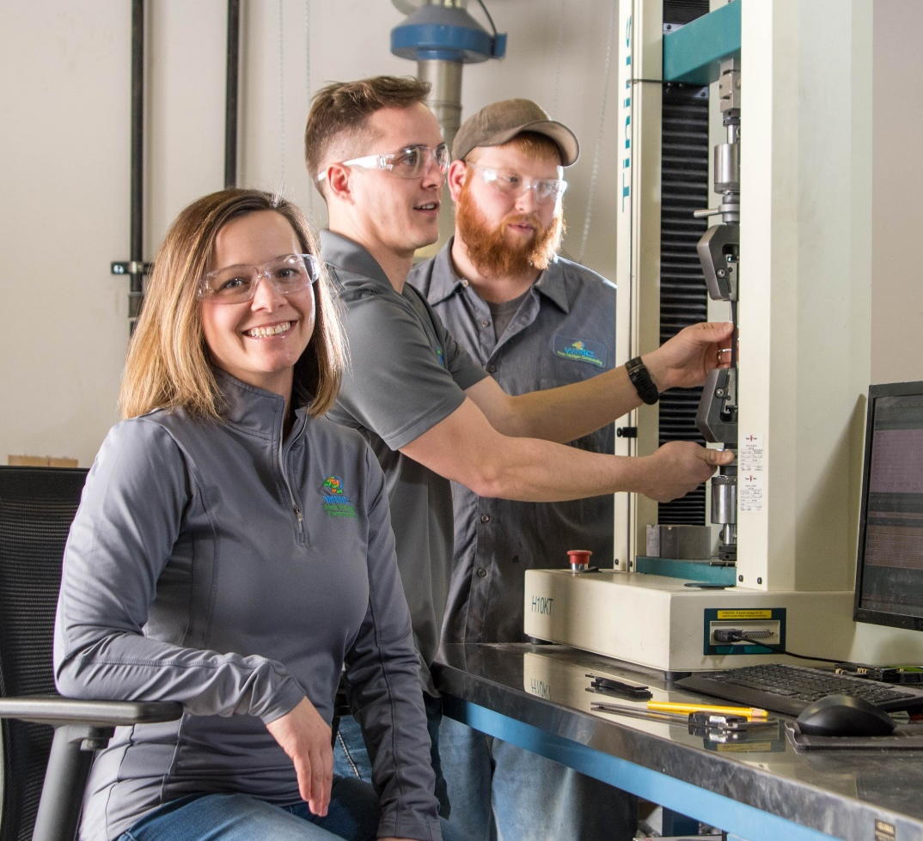
Workforce training
MCC partners with area business, industry
and organizations
to design workforce
training to meet
individual business
needs.
MCC offers
customized
apprentice training.
Notes:
Customized workforce training
Professional development
Small business and entrepreneur resources
WorkKeys testing
SCORE

Slide 17
Lifelong Learners
MCC’s Lifelong Learners offers
educational sessions for those
age 18 and older.
Fall 2019 offerings:
  Sept. 13, 10 a.m. to noon, “Good Grief,
  Charlie Brown,” by Maureen Burns and
  Deb Christensen
  Sept. 27, 10 a.m. to noon, “West Side Story,”
  by Jeff Cook
  Oct. 11, 10 a.m. to noon, “Speaking on Silent
  Movies of the Silver Theater,” byKeith Hudson
  Oct. 25, 10 a.m. to noon, “What’s so Great About
  the Great Lakes,” by Dr. Michael Stafford
Notes:
Cyber crime and security
The history of Montcalm Community College
The Hidden Art of Montcalm County

Slide 18
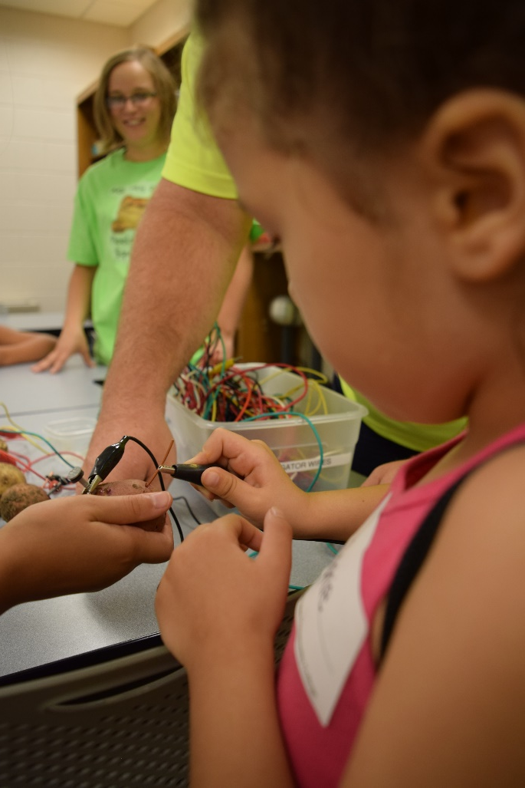
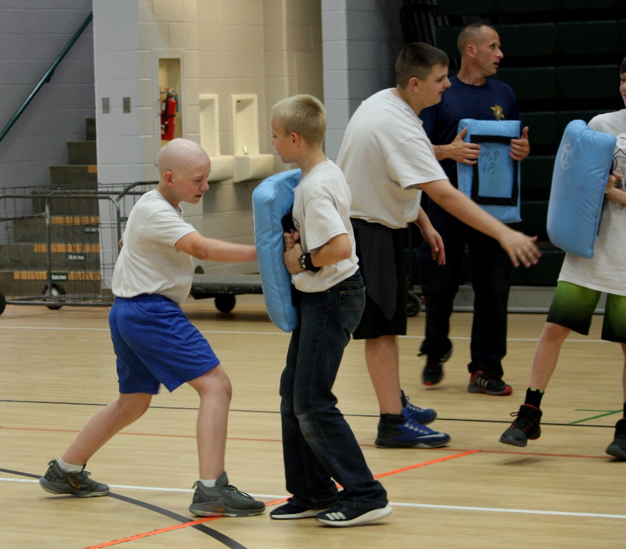
Summer camps
MCC offers a variety of
summer camps for youths.

Slide 19
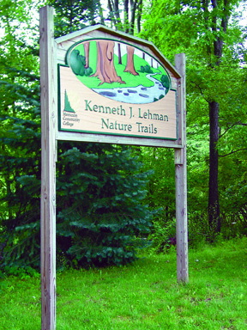
Outdoor recreation
MCC’s Kenneth J. Lehman
Nature Trails feature more
than 4 miles of marked trails
with maps available at most
trail heads. There is no charge
to visit these beautiful trails,
which wind through forests, grasslands and wetlands.
Notes:
Located on MCC’s Sidney campus.
Boasts more than 3 miles of maintained trails.
Self-guided tour maps are available at the trail access points on campus.

Slide 20
Pool
MCC’s NCAA-sized pool is open to the public for use.
Swimming lessons
Open swim
Water walking
Lap swim

Slide 21
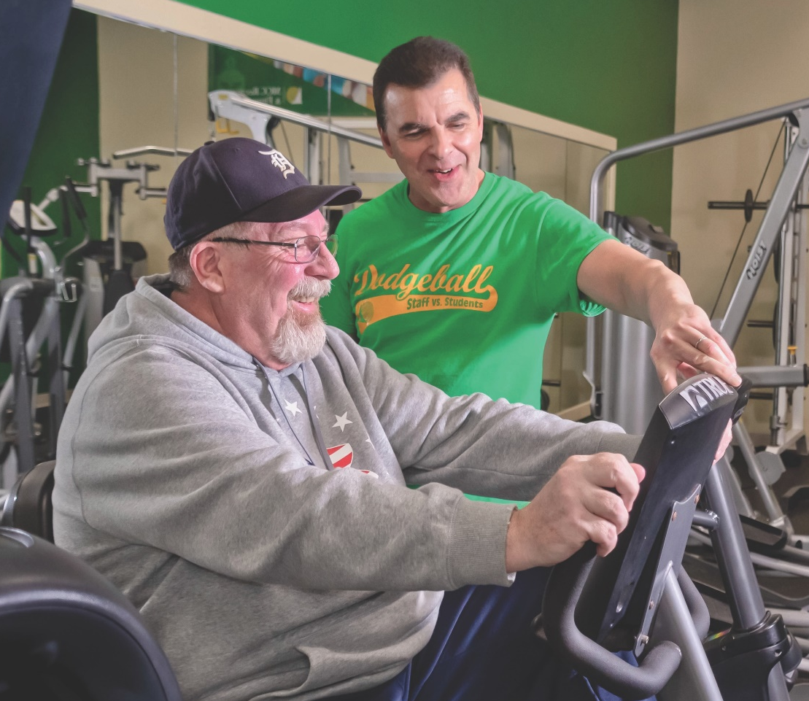
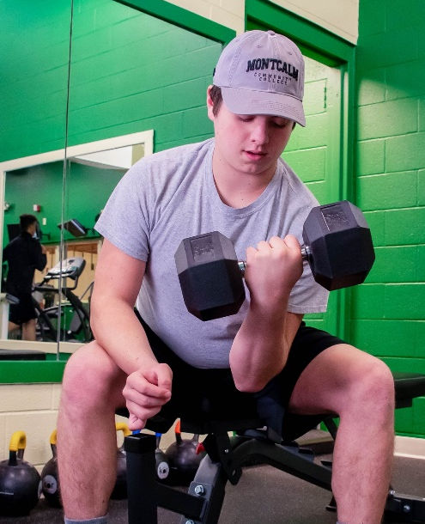
Gym and fitness center
MCC offers open gym and fitness center hours, fitness classes, personalized training and much more.
Notes:
MCC’s facilities are open to the public.
Basketball and volleyball
Fitness center with modern exercise equipment

Slide 22
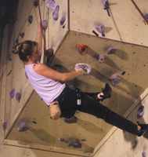
Indoor climbing wall
Experience rock climbing
for fun and fitness on
MCC’s indoor
rock climbing wall.

Slide 23
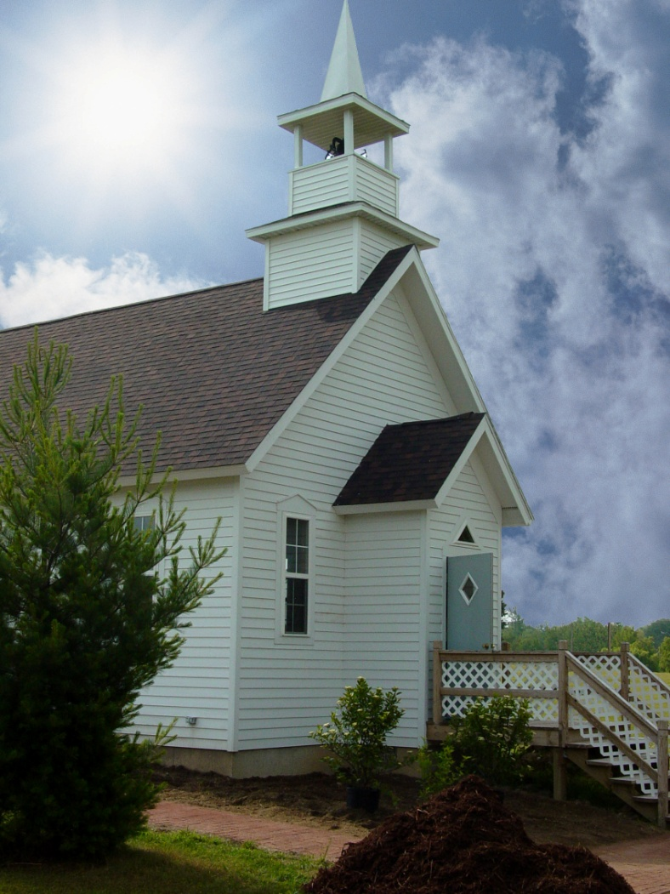
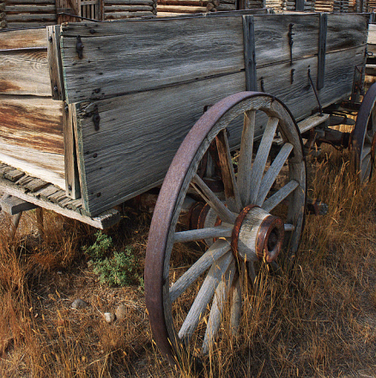
Montcalm Heritage Village
Historic Montcalm
Heritage Village …
where history is
more than a picture.
Notes:
Established in 1987 on MCC’s Sidney campus
Includes 25 historic buildings and hundreds of artifacts from local areas depicting life in Michigan at the turn of the 20th Century.
Annual Heritage Festival is the first weekend of August

Slide 24
Contact us
Thank you for your continued support of Montcalm Community College.
For more information:
    www.montcalm.edu
    Call 989-328-2111

